Slide 1

Covid - 19
Max Sohl, Sneha Sabu, Ehab Abdo, Rasa Blourtchi, Vibeesh Kamalakannan, Harshal Suryawanshi, & Raghav Arora

Slide 2
Business Opportunities
Early detection, isolation and medication for COVID-19 cases based on symptoms, can help reduce tranmission and lower death rates during times where lab resources are overwhelmed.
Get better understanding for the virus transmission mechanism for informed decision concerning social contact limits and stay at home orders.
Understand if elderly people are more susiptable to covid-19 infection to support strict infection control practices and monitoring decision in nursing homes and similar facilities.
Prioritize vaccination for more valenerable population.
Notes:
The data collected by the Israeli Ministry of Health is critical in developing a better understanding of the main characteristics and symptoms associated with COVID-19 cases. This understanding enables the Ministry to develop efficient, data-driven plans and make informed decisions in their fight against COVID-19.

Slide 3
Business Questions
Does older age increase the risk of contracting COVID-19?
Does contacting a person who has COVID-19 significantly increases the likelihood of becoming infected with the virus?
What are the most common and alerting symptoms for COVID-19 infection?
Can we develop an accurate model for predicting COVID-19 cases based on symptoms, age, and sex?
Are there differences in COVID-19 symptoms between males and females or different age groups?"
Notes:
As discussed in the previous slide the provided dataset presents numerous business opportunities that can be explored through data mining and analytics techniques.
To achieve this, we have identified the critical business questions that we aim to answer through different data mining techniques

Slide 4
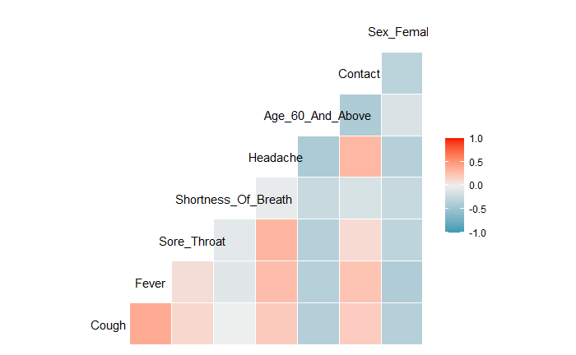
Data Understanding
There is a high positive correlation between cough and fever
Contact with an infected person correlates highly with symptoms such as cough, fever, and sore throat
Notes:
We explored the dataset using graphs to better understand the relationship between different variables. A correlation plot between all the symptom variables showed that there is a high positive correlation between Cough and Fever. Also, several symptoms such as cough, fever, and sore throat are positively correlated with Contact.
We used graphs to understand the relationship between variables in the dataset. A correlation plot indicated a strong positive correlation between Cough and Fever. Additionally, symptoms like cough, fever, and sore throat are positively linked with Contact.

Slide 5
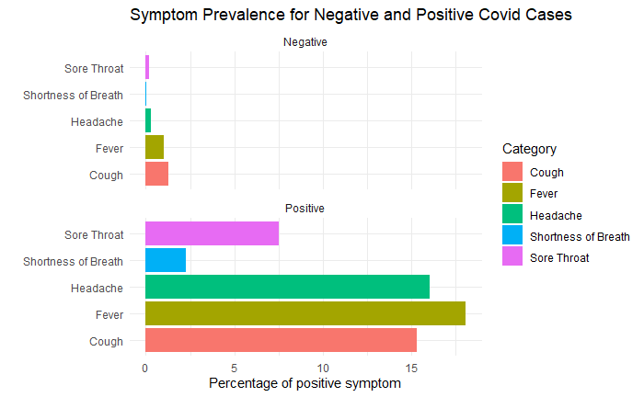
Data Understanding
Those with negative results report symptoms less than 5% of the time
Individuals who test positive for Covid report symptoms such as headache, fever, and cough more than 15%
Notes:
This faceted bar chart shows that people who test negative for Covid report symptoms such as headache, fever, and cough less than 5% of the time whereas, those with a positive test result report those symptoms more than 15%

Slide 6
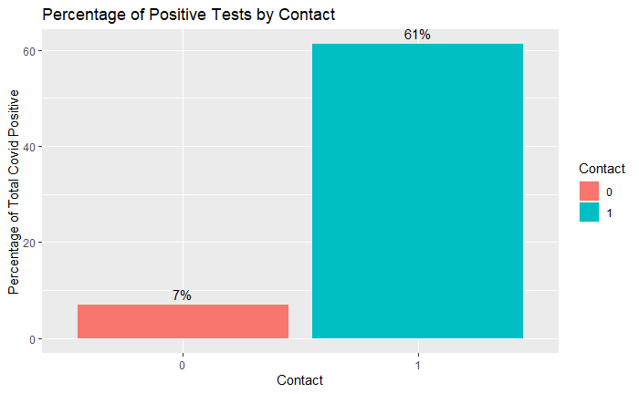
Data Understanding
61% of people who had contact with an infected person tested positive
7% of those who did not have contact with an infected person
Notes:
Of the total number of people who tested Covid positive, 61% of them came in contact with a covid infected person.

Slide 7
Supervised Modeling
Covid19 Prediction and Symptom Significance Analysis
We split the entire dataset into 60% for training and 40% for testing
Train (60%)
Test (40%)

Slide 8
Naive Bayes
The model that we created had a very great sensitivity
Although this is fantastic, our specificity was horrible
We decided to drop this model
It would be valuable to accurately identify all people who are infected
However, specificity is too low for this model to be taken seriously
Model Name | Sensitivity | Specificity | Accuracy
Naïve Bayes | 0.9998 | 0.0069 | 0.8952

Slide 9
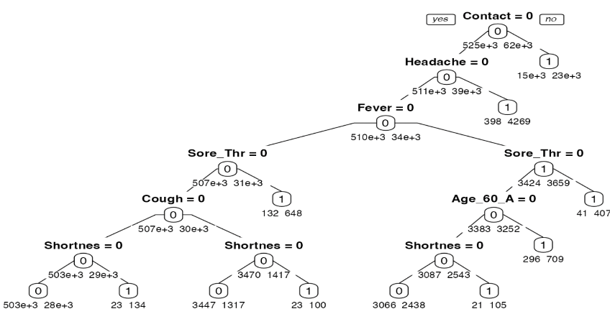
Decision Tree and Ensemble Tree
Best pruned Decision Tree provided the best sensitivity of 54.4% among all decision- based models.
Contact followed by Headache are the most significant symptoms for covid-19 prediction
Model Name | Hyper parameter | Sensitivity | Specificity | Accuracy | ROC-AUC
Decision Tree | Cp = 4.5293e-04 | 0.54387 | 0.95686 | 0.9134 | 0.7538
Bagging | ntree= 100, mtry = 8 | 0.43055 | 0.97640 | 0.9189 | 0.7418
Random Forest | ntree= 100, mtry = 3 | 0.52822 | 0.96297 | 0.9172 | 0.7491

Slide 10
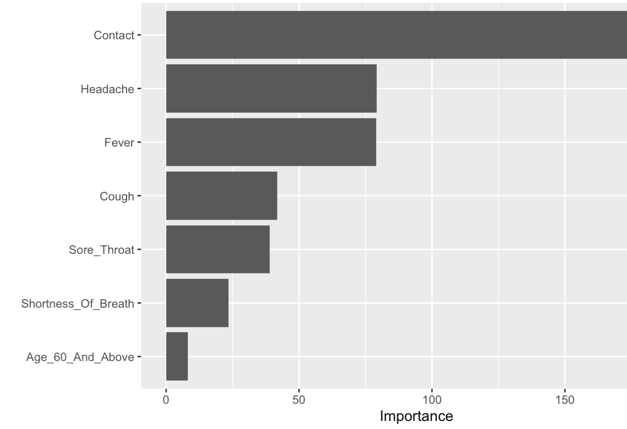
Logistic Regression
The Logistic model that we created had a very high sensitivity
Specificity being the most important for our analysis, value of 0.5 was considerably better than other models
Predicting people who are infected correctly is most important here
Model Name | Sensitivity | Specificity | Accuracy | ROC-AUC
Logistic Classification | 0.9570 | 0.5346 | 0.9125 | 0.7504

Slide 11
Best Supervised Data Minning Model
Logistic classification
Binary Choice Model
Accuracy is similar across the models
Focused on specificity and sensitivity
Model Name | Hyper parameter | Sensitivity | Specificity | Accuracy | ROC-AUC
Naïve Bayes | - | 0.998 | 0.0069 | 0.8952 | -
Logistic Classification | - | 0.9570 | 0.5346 | 0.9152 | 0..7504
Decision Tree | ntree = 100, mtry = 8 | 0.43055 | 0.97640 | 0.9189 | 0.7538
Bagging | ntree= 100, mtry = 8 | 0.43055 | 0.97640 | 0.9189 | 0.7418
Random Forest | ntree= 100, mtry = 3 | 0.52822 | 0.96297 | 0.9172 | 0.7491
Notes:
Max

Slide 12
Unsupervised Modelling
Covid19 Sex and Age Group clustering
Descriptive Analytics
Notes:
Vibes

Slide 13
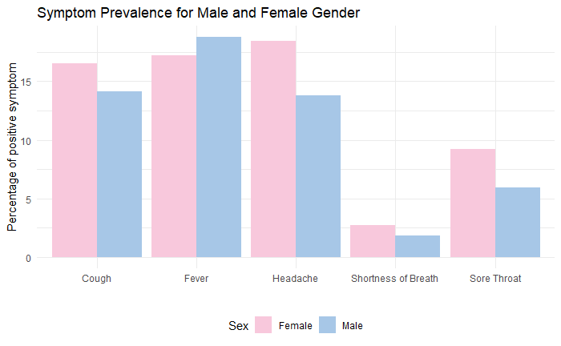
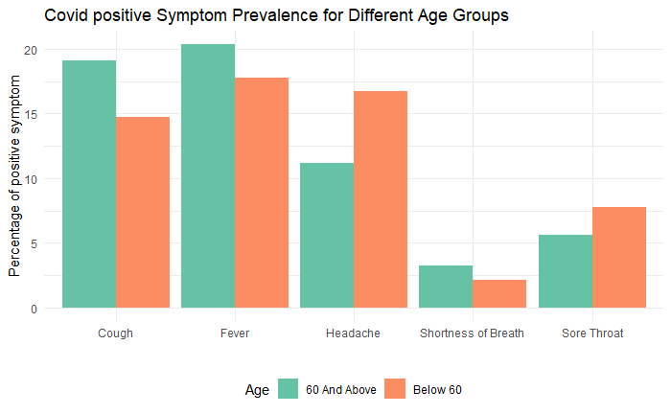
K-Means
K-Mean Clusters | Cough | Fever | Sore_Throat | Shortness_Of_Breath | Headache | Age_Above_60 | Male
1 (Female) | 17% | 17% | 9% | 3% | 18% | 12% | 0
2 (Males) | 14% | 19% | 6% | 2% | 14% | 13% | 1

Slide 14
Evaluation
Does older age increase the risk of contracting COVID-19?
Does contacting a person who has COVID-19 significantly increases the likelihood of becoming infected with the virus?
What are the most common and alerting symptoms for COVID-19 infection?
Can we develop an accurate model for predicting COVID-19 cases based on symptoms, age, and sex?
Are there differences in COVID-19 symptoms between males and females or different age groups?"
Predictors | Log Odds
Cough | 2.68
Fever | 6.03
Sore Throat | 6.47
Shortness of Breath | 7.70
Headache | 13.17
Age 60 & Above | 1.13
Contact | 12.29
Male | 1.30
K-Mean Clusters | Cough | Fever | Sore_Throat | Shortness_Of_Breath | Headache | Age_Above_60 | Male
1 (Female) | 17% | 17% | 9% | 3% | 18% | 12% | 0
2 (Males) | 14% | 19% | 6% | 2% | 14% | 13% | 1
Notes:
Gav

Slide 15
Recommendations
Publish the findings of this analysis on the Ministry of Health website and other public websites.
Prioritize testing for symptoms of headaches and shortness of breath over cough, fever and sore throat.
Make quarantining mandatory for at least 2 weeks after a positive covid result.
Reinforce vaccinations and masks in public spaces as contact with an infected person is the most important predictor of having a positive covid result.
Treat gender and age similarly when testing for covid but not after a person receives a positive test result.
For a positive covid test result, treat females for cough, sore throat and headaches more often and males for fever more often.
For a positive covid test result, treat people above 60 for cough, fever and shortness of breath more often and people under 60 for headaches and sore throat more often
Notes:
Gav

